Slide 1

Document Tracker Application
- A Spring-Boot Application
Team Members:
1. S. Sisvanth Kumar
2. N. Naveen Kumar

Slide 2

This is a Spring-boot based Application
developed on Spring-Tool-Suite IDE , which
is used to keep track of documents
submitted by the user(client) and store the
documents in a database to keep a track of
it.
Abstract
Of
Project

Slide 3

Link :-
Walk-through of our application:
(video demonstration)
https://drive.google.com/file/d/1OaEUIeb2TztDc0KnNWF9yyCtpPDB
eofC/view?usp=sharing
Link to GitHub Repository:
https://github.com/Sisvanthkumar/Sirius_2022

Slide 4
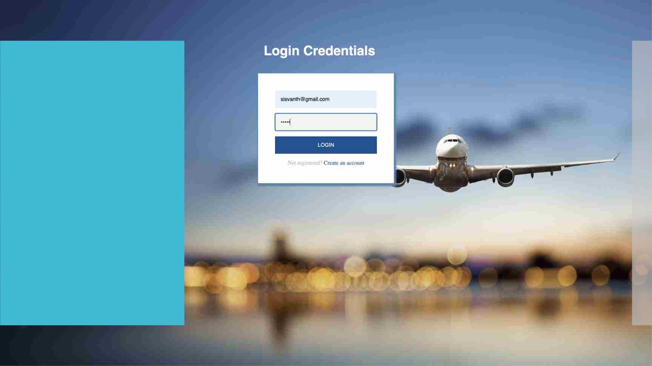
Login Page :
ØA Simple Login Page for User
Authentication for the
Document Tracker
Application.
ØThe Login Page is rendered
from the “/home” endpoint
specified in the controller.

Slide 5
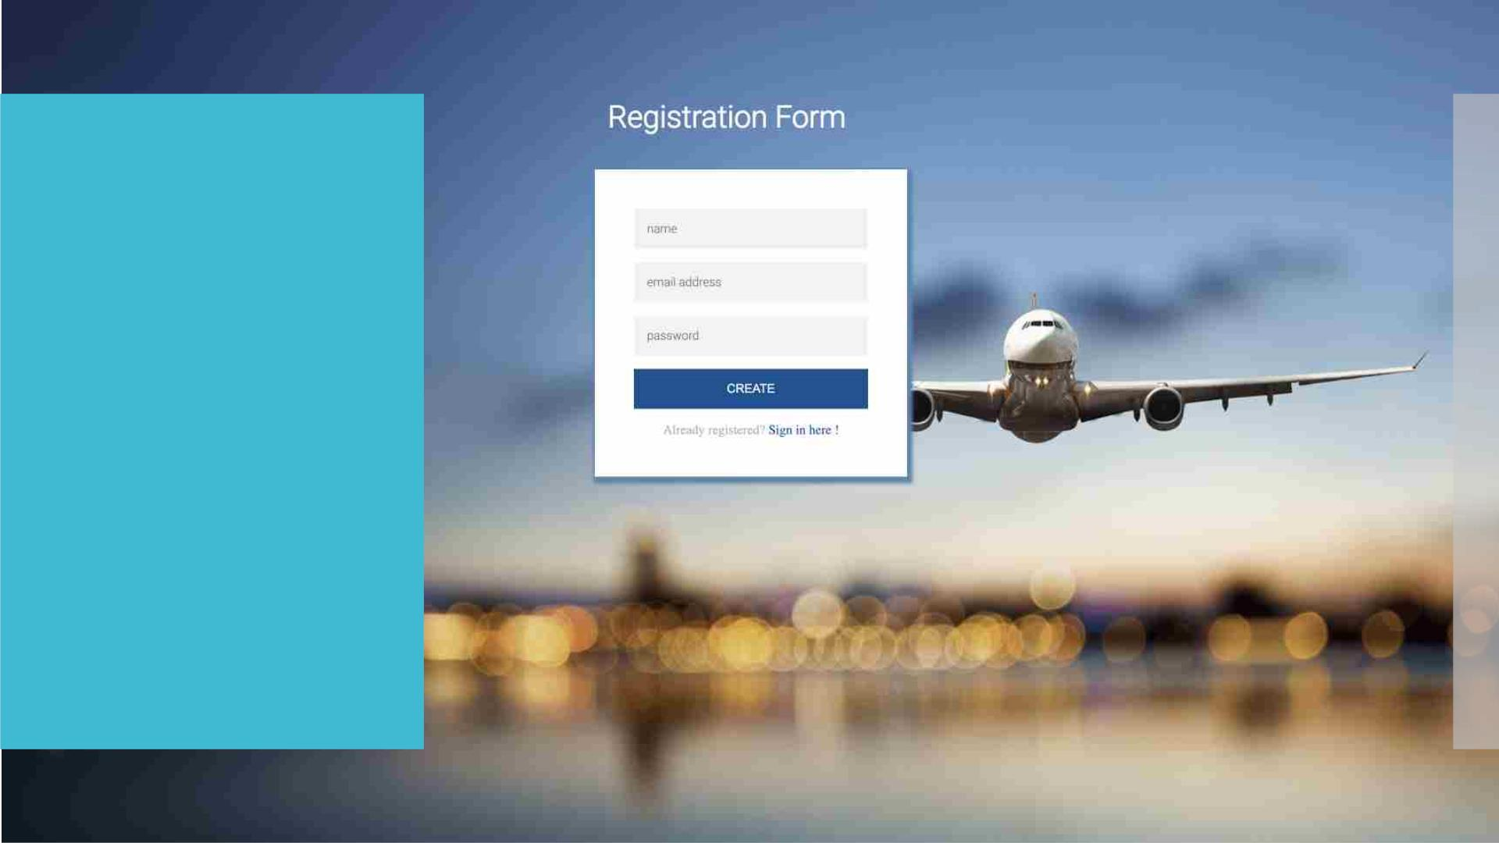
Registration Page :
ØA Registration Page for
User to register their user
credentials for the
Document Tracker
Application.
ØThe Registration Page is
rendered from the
“/register” endpoint
specified in the controller.

Slide 6
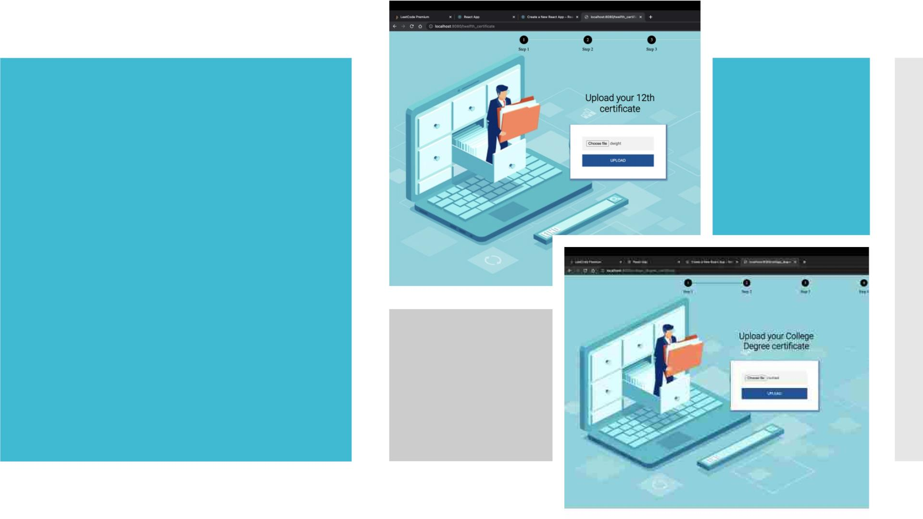
Document Upload Pages :
ØDocument upload page for uploading
Ø -> 12 Certificate from the endpoint
th
“/twelfth_certificate”
Ø -> College degree Certificate from the
endpoint“/college_degree_certificate”.
Ø -> Aadhar card from the endpoint
“/aadhar_card”.
Ø -> Pan card from the endpoint “/pan”.

Slide 7
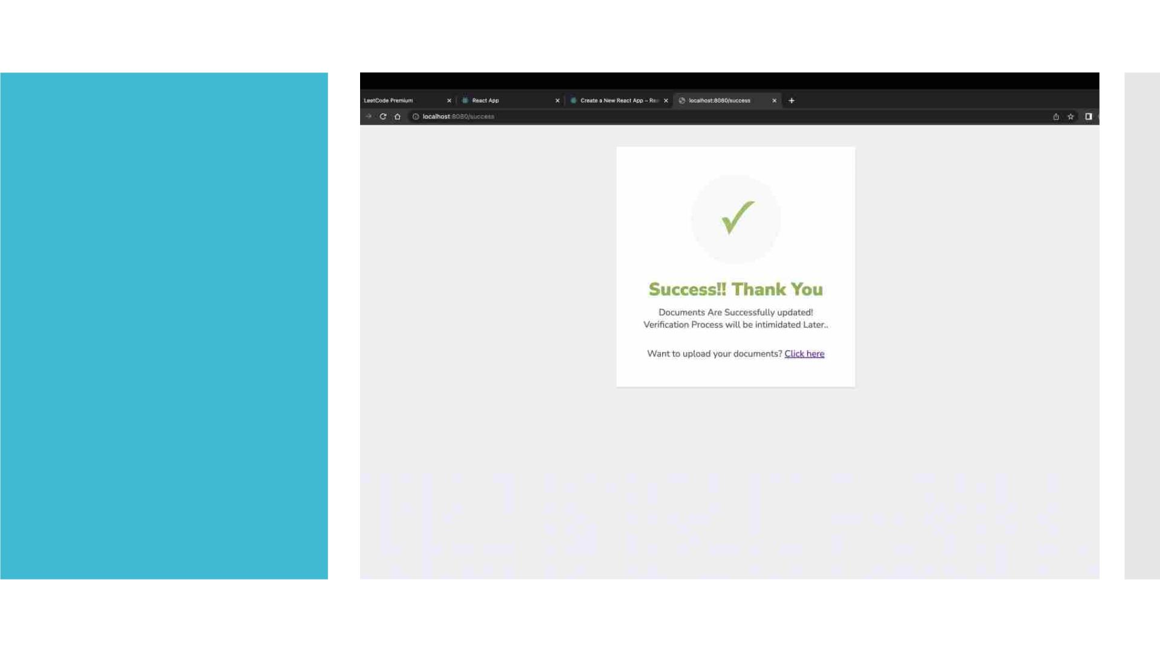
Verified Page :
 This page shows that
you document upload
process has successfully
completed .
 If you click on the “click
here” link it redirects
you back to the home-
page.

Slide 8
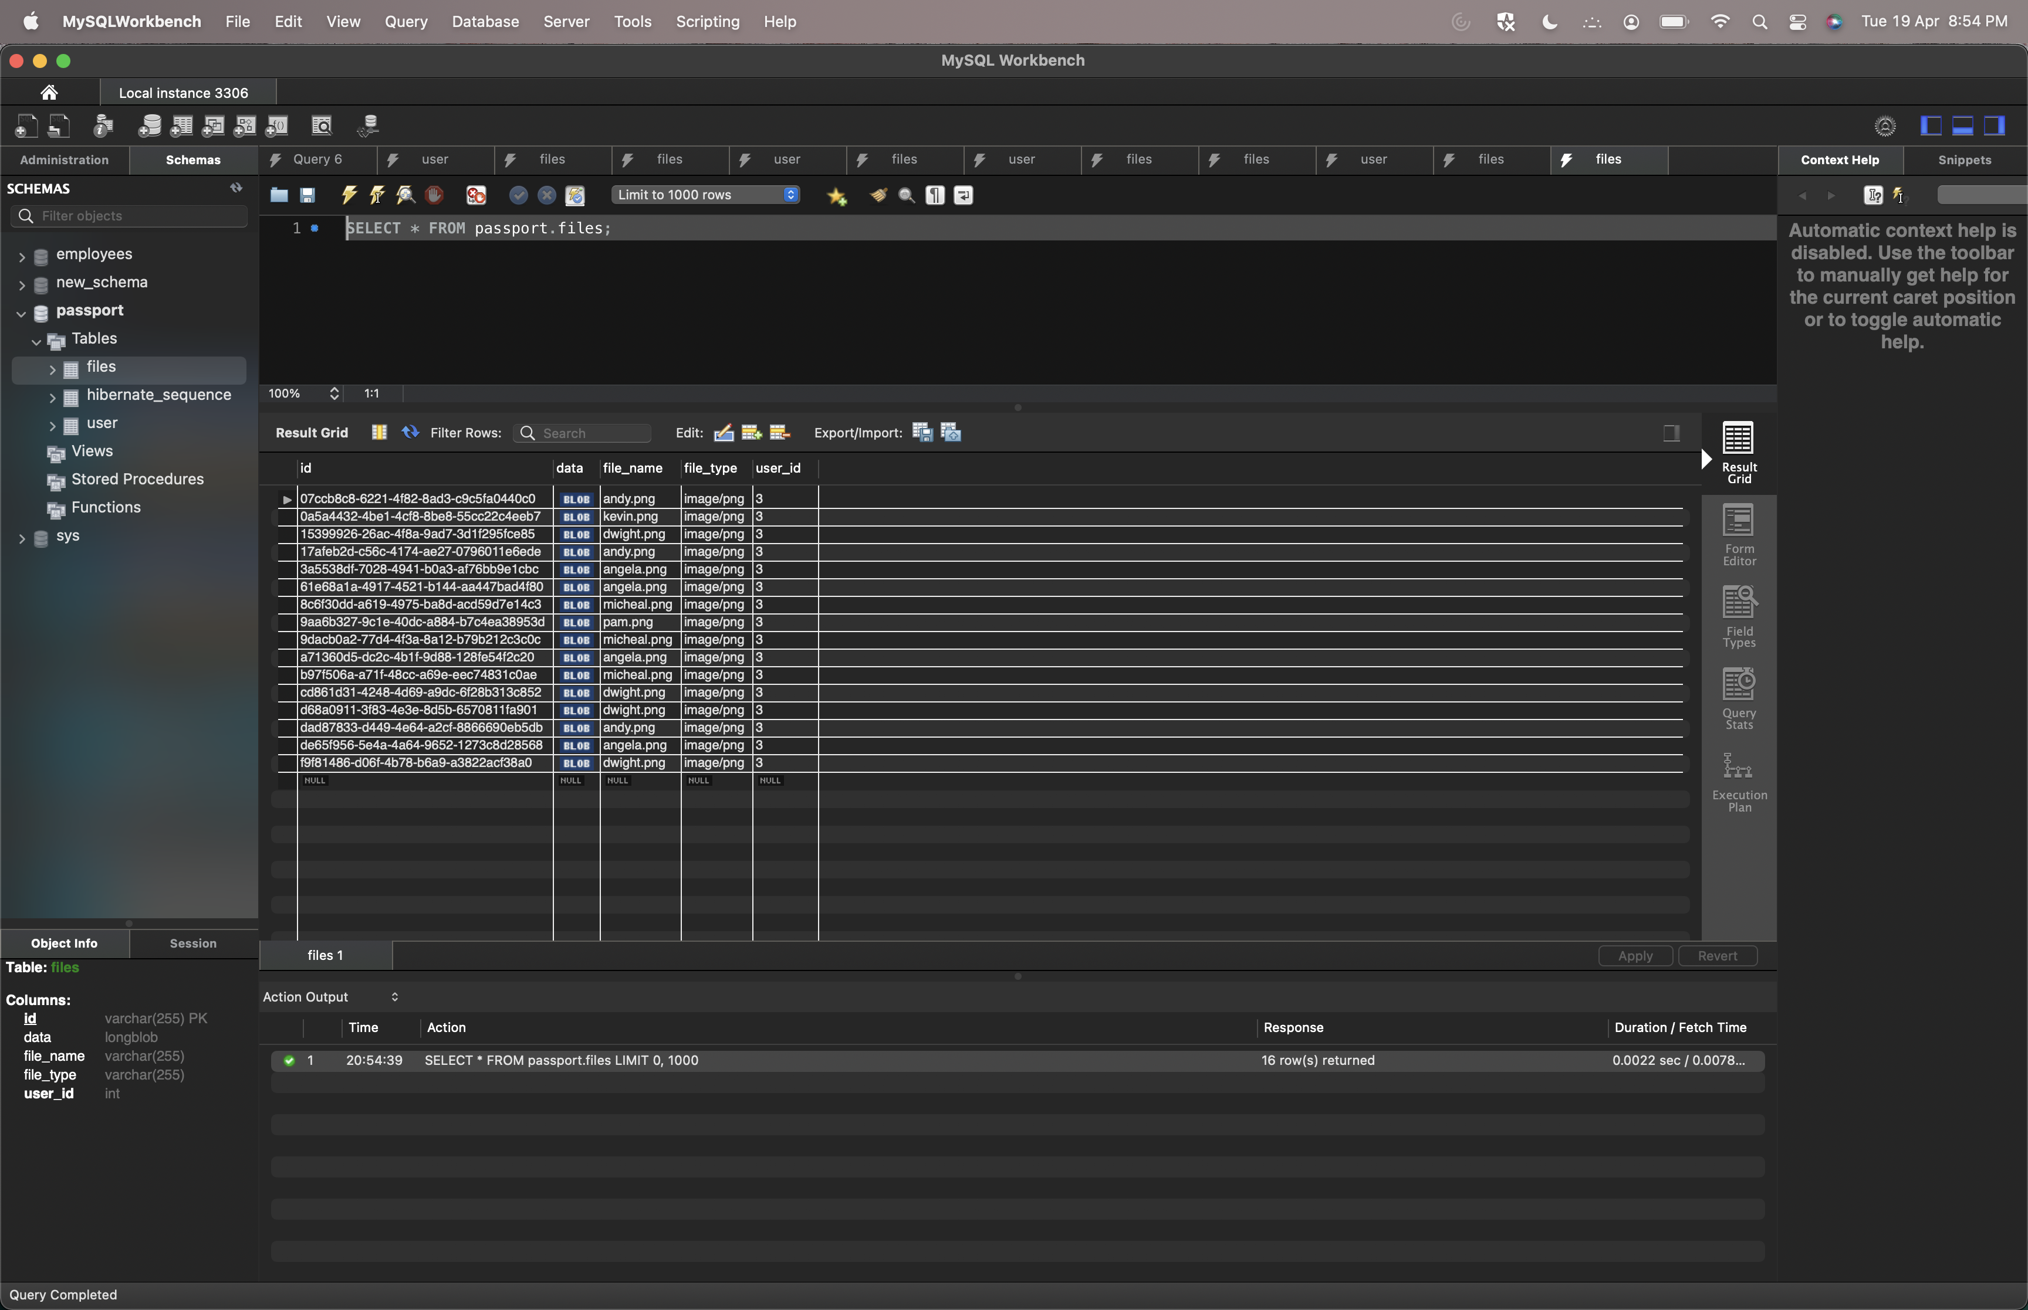
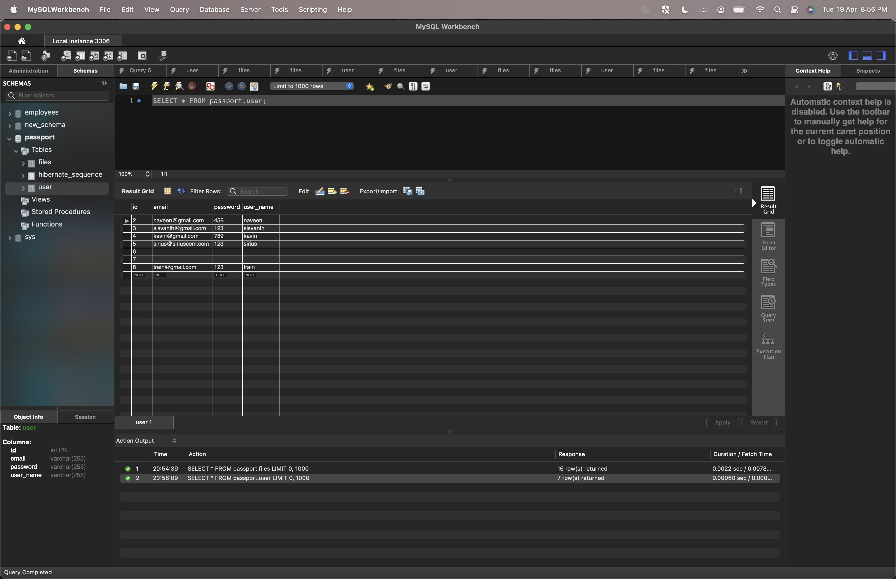
DATA-BASE:
1) MySQL WorkBench is used for storing data collected from the application. It consists of two tables one for adding new user and another for storing the documents of the respective user . 2) Both these tables are connected by taking user object as “Foreign Key”

Slide 9

Thank you !!!

